Slide 1

About Sri Lanka
This tiny, drop shaped island - just over 65,000sq.km. in extent, lies off the southern tip of India with the sun shining year round a documented history dating back to 500 years B.C. A rich cultural heritage nurtured by the Buddhist faith, breathtakingly beautiful landscapes ranging from sea level to over 1890 metres in the high country. Palm fringed golden beaches that rim the coastline, Sri Lanka never fails to fascinate the visitor.
To meet in Sri Lanka is to be amidst beauty, warmth & hospitality, Amongst people who know how to make your stay satisfying & memorable.
"THE FINEST ISLAND IN ALL THE WORLD" (Marco Polo - Explorer)

Slide 2
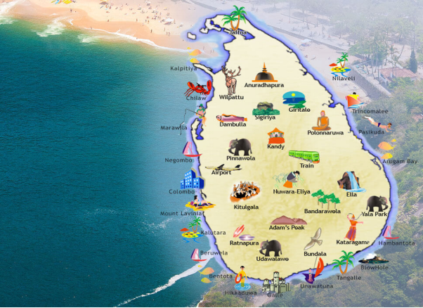

Slide 3
Distance & duration chart
CITIES | DISTANCE (kms.) | DURATION
Colombo/Kandy | 115 | 3 hrs
Airport/Colombo | 37 | 1 hrs
Colombo/Beach area South | 64 | 1 hr 50min
Colombo/Kandalama | 125 | 4 hrs
Airport/Negombo | 10 | 15 min
Kandalama/Kandy | 80 | 2 hr 15min
Kandy/Nuwara Eliya | 77 | 3 hrs
Nuwara Eliya/Colombo | 189 | 6 hrs

Slide 4
BANDARANAIKE INTERNATIONAL AIRPORT (COLOMBO)
Airport Transfer
To city centre : Taxi : USD 49 (29 km/19 miles)
Customs Allowed
Tobacco Products: 200 cigarettes or 100 cigarillas or 50 cigar or 12 ozs tobacco.
Alcoholic Beverages: 2 litres of wine & 1.5 litres spirits.
Others: 2 ozs perfume & o.25 litre of eau-de-toilette.
The Medical Center is located at the Arrival Immigration Area.

Slide 5
A Glance at Airport Facilities
A Child Care Center is located at the Transit Area. Shower rooms are available at the Terminal. Day rooms are also available.
The business center is located on Ground Floor, Transit Area.
The Medical Center is located at the Arrival Immigration Area.

Slide 6
Facts for Travellers
Geography
An island of 65,610 sq. km, Sri Lanka lies in the Indian Ocean off the southern tip of the coast of India. The coastline gives way to lowland plains, growing rice and coconut. In the mid country rubber vies with gems, while green carpets of tea clothe the central mountain ranges reaching heights of some 2,432 metres.
Climate
Warm and fine year round. Average temperatures around 27°C in Colombo going down as the land rises to the hill country to as low as 10°C. The island has two wet seasons between May and July in the southwest and December/January in the northeast. Climatically Sri Lanka has no off-season. Bright sunny warm days are the rule and are common even during the wet season. Sea temperatures as a rule remain around 27°C.

Slide 7
Facts for Travellers
Language
Communication is rarely a problem because English is widely spoken in all parts of the country. Place names and signboards are in the national languages Sinhala, Tamil and English.
Official languages Sinhala, Tamil and English.
National Languages - Sinhala and Tamil.
Religion
Predominantly Budhists but also Hindus, Muslims & Christians.
Currency
The currency of Sri Lanka is the Rupee divided into cents. Foreign currencies enjoy a favourable exchange rate.

Slide 8
Activities in Srilanka
SRILANKA - "WINNER" OF A VENUE
Sri Lanka can offer a variety of venues with excellent facilities that meet the most stringent standards for any conference or meeting for up to 2000 delegates.
Today, Sri Lanka is reputedly Asia's latest destination for MICE tourism.
AYURVEDA TREATMENT
Healing at your fingertips Soothe your frazzled nerves. Relax all tension knots. Unwind in the caring hands of expert Ayurvedha masseurs & masseuses. Be healed by the properties of Sri Lanka's finest herbs. The best mix of Eastern & Western hospice.

Slide 9
SHOPPING
Like everything else in this truly resplendent island, Shopping is both diverse & delightful. Discover a dazzling treasure trove of gemstones & exquisite jewellery, browse amongst a stunning array of shimmering silk & sculptured silver, brightly hued batiks & burnished brassware, sapid spices & the finest tea in the world, heart stopping "Devil" masks
EATING JOINTS
NEGOMBO
Recommended restaurant and bar - The Brown Beach hotel's eating joints and bar are the best around. Good service.
KANDY
Recommended restaurant - Queens Hotel (opposite Temple of the Tooth) has good restaurants. If in mood for Chinese, try Flower Song (Kotugodella Vidiya) and for home cooking, the lovely Sharon Inn (Saranankara Rd).
Recommended bar - Unnamed pub next to Queens Hotel.

Slide 10
COLOMBO
Recommended restaurant - Ports of Call, Taj Samudra. A 24-hour joint for some authentic local as well as European flavors.
Recommended bar - Cricket Club Cafe (Queens Rd) continues a theme, while architect Geoffrey Bawa's former office at the Gallery Cafe (Alfred House Road) is stunning, with food to match.
ENTERTAINMENT
WATER SPORTS
Possibly one of the best spots in Asia play in water. Beach games, wind surfing, water skiing, boating, swimming, diving and snorkeling are popular activities. Diving schools run by experienced divers help the amateur. Submerged wrecks in Sri Lanka's coastal waters are an added attraction to the skilled divers. You could try your hand at these thrilling sports at Negombo.
NIGHTLIFE
Most discos and night clubs are located in five star hotels. The Blue Elephant at Hilton Colombo is a 'happening' joint to hang out till wee hours of the morning. Alcohol too flows freely in this and most other 5 star bars in Sri Lanka. The country has probably the largest per capita consumption of alcohol in the whole of Asia !

Slide 11
Sample Packages:
Beach Delight - [04 Nights/05 Days]
02 Nights in Bentota
02 Nights in Mirissa
Package cost per person on twin/double sharing basis INR 31900.00
Family Vacation - [05 Nights/06 Days]
02 Nights in Kandy
02 Nights in Bentota
01 Night in Colombo
Package cost per person on twin/double sharing basis INR 33900.00

Slide 12


